Slide 1


St. MARTIN’S ENGINEERING COLLEGE
UGC Autonomous
NBA & NAAC A+ ACCREDITED
Dhulapally, Secunderabad – 500 100
Department of
ARTIFICIAL INTELLIGENCE & DATA SCIENCE
Mini Project on
Loan Eligibility Prediction for Banks using Machine Learning
Batch No: 13
1. M. Rajesh (23K81A7296)
2. K. Sree Akhil (23K81A7292)
3. CH. Ram Mahideep Varma (23K81A7279)
Under the Guidance of
Mr. V. Vishnu Vardhan
Assistant Professor
Department of Artificial Intelligence & Data Science

Slide 2
OUTLINE
Abstract
Existing System
Proposed System
Architectural Design for Proposed System
ER Diagram
Algorithms/ Techniques used
Implemented Code
Expected Outcomes
References

Slide 3
ABSTRACT
With technological advancements and the expansion of businesses, the demand for loans has increased significantly, both for personal and business purposes. Due to limited assets, banks cannot grant loans to every applicant. Identifying the right candidates for loans is a complex and time-consuming process. Banks aim to deliver loans to individuals who can repay them on time and provide maximum profit. Thus, there is a need for a system that can analyse and streamline this process, saving time and resources. This paper aims to develop a more accurate loan prediction model using machine learning to reduce the risk involved in selecting appropriate loan applicants. By mining previous loan records and using bank loan rules, we will train a machine learning model to predict loan eligibility. We will use the sklearn library for our model and the train - test-split method to split the dataset. Various models, including Logistic Regression, Decision Tree (DT), Random Forest (RF), and Support Vector Machine (SVM), will be employed to achieve accurate results. Our experiments indicate that the Random Forest classifier provides the best accuracy.

Slide 4
EXISTING SYSTEM
1. In the existing loan approval system, banks follow a manual and rule-based process to evaluate whether a customer is eligible for a loan. Loan officers review the applicant’s documents, verify financial information, and make decisions based on fixed guidelines and personal judgment.
2. Manual Verification of Documents.
3. Rule-Based Decision Making.
4. High Dependency on Human Judgment.
5. Slow and Inefficient Process.
DISADVANTAGES:
1. Time-consuming manual work.
2. Possibility of human bias and error.

Slide 5
PROPOSED SYSTEM
The proposed system introduces an automated, machine-learning–based loan eligibility prediction model that assists banks in making faster, more accurate, and data-driven loan decisions. Instead of relying on manual verification and judgement-based approval, the system analyses historical loan data and identifies patterns that indicate whether a customer is likely to repay the loan.
Automated Decision Making.
Data Preprocessing and Feature Engineering.
Machine Learning-Based Prediction.
ADVANTAGES:
Faster loan processing.
Higher accuracy due to data-driven decisions.

Slide 6
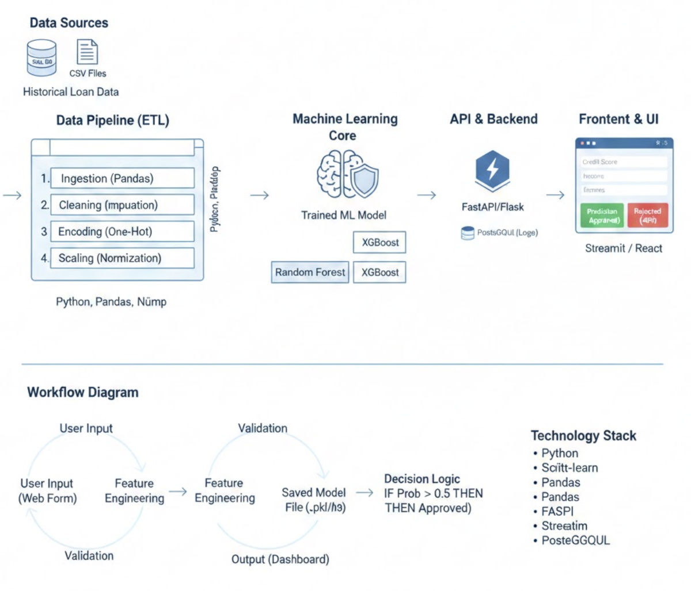
ARCHITECTURE DESIGN FOR PROPOSED SYSTEM

Slide 7
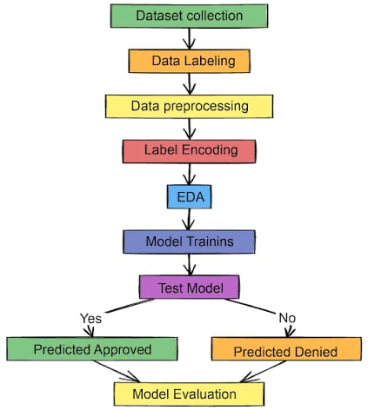
ER DIAGRAM/ FLOW DIAGRAM

Slide 8
ALGORITHMS AND TECHNIQUES USED
1. Core Machine Learning Algorithms
Random forest: It creates hundreds of individual “Decision Trees” and lets them vote on the outcome.
XGBoost (Extreme Gradient Boosting): It built trees sequentially, where each new tree specifically tries to correct the errors made by the previous ones.
Logistic Regression: A statistical model that calculates the probability of a binary event using a sigmoid function.
2. Key Data Science Techniques
Handling Class Imbalance (SMOTE)
Feature Scaling (Normalisation)
Categorical Encoding

Slide 9
IMPLEMENTED CODE
import pandas as pd
import numpy as np
from sklearn.model_selection import train_test_split
from sklearn.preprocessing import LabelEncoder
from sklearn.ensemble import RandomForestClassifier
from sklearn.metrics import accuracy_score, classification_report
# 1. LOAD DATASET
# Replace 'loan_data.csv' with your actual dataset file path
def load_and_preprocess_data(file_path):
df = pd.read_csv(file_path)
# 2. DATA PREPROCESSING (Handling Missing Values)
# Fill categorical missing values with Mode
df['Gender'].fillna(df['Gender'].mode()[0], inplace=True)
df['Married'].fillna(df['Married'].mode()[0], inplace=True)
df['Dependents'].fillna(df['Dependents'].mode()[0], inplace=True)
df['Self_Employed'].fillna(df['Self_Employed'].mode()[0], inplace=True)
df['Credit_History'].fillna(df['Credit_History'].mode()[0], inplace=True)

Slide 10
# Fill numerical missing values with Median
df['LoanAmount'].fillna(df['LoanAmount'].median(), inplace=True)
df['Loan_Amount_Term'].fillna(df['Loan_Amount_Term'].median(), inplace=True)
# 3. FEATURE ENGINEERING (Label Encoding)
# Convert categorical strings to numeric values for the ML model
le = LabelEncoder()
categorical_cols = ['Gender', 'Married', 'Education', 'Self_Employed', 'Property_Area', 'Loan_Status']
for col in categorical_cols:
df[col] = le.fit_transform(df[col])
return df
# 4. MODEL TRAINING
def train_loan_model(df):
# Drop Loan_ID as it doesn't contribute to prediction
X = df.drop(columns=['Loan_ID', 'Loan_Status'])
y = df['Loan_Status']
# Split data: 80% Training, 20% Testing
X_train, X_test, y_train, y_test = train_test_split(X, y, test_size=0.2, random_state=42)
# Initialize Random Forest Classifier
model = RandomForestClassifier(n_estimators=100, random_state=42)
model.fit(X_train, y_train)

Slide 11
# Predictions and Evaluation
y_pred = model.predict(X_test)
print(f"Model Accuracy: {accuracy_score(y_test, y_pred) * 100:.2f}%")
print("\nClassification Report:\n", classification_report(y_test, y_pred))
return model
# 5. AUTOMATED DECISION MAKING (Prediction Function)
def predict_eligibility(model, input_data):
"""
input_data: list of values [Gender, Married, Dependents, Education, Self_Employed,
Applicant Income, Co applicant Income, LoanAmount,
Loan_Amount_Term, Credit_History, Property_Area]
"""
prediction = model.predict([input_data])
return "Eligible" if prediction[0] == 1 else "Not Eligible"
# Execution Example
# data = load_and_preprocess_data('loan_data.csv')
# trained_model = train_loan_model(data)

Slide 12
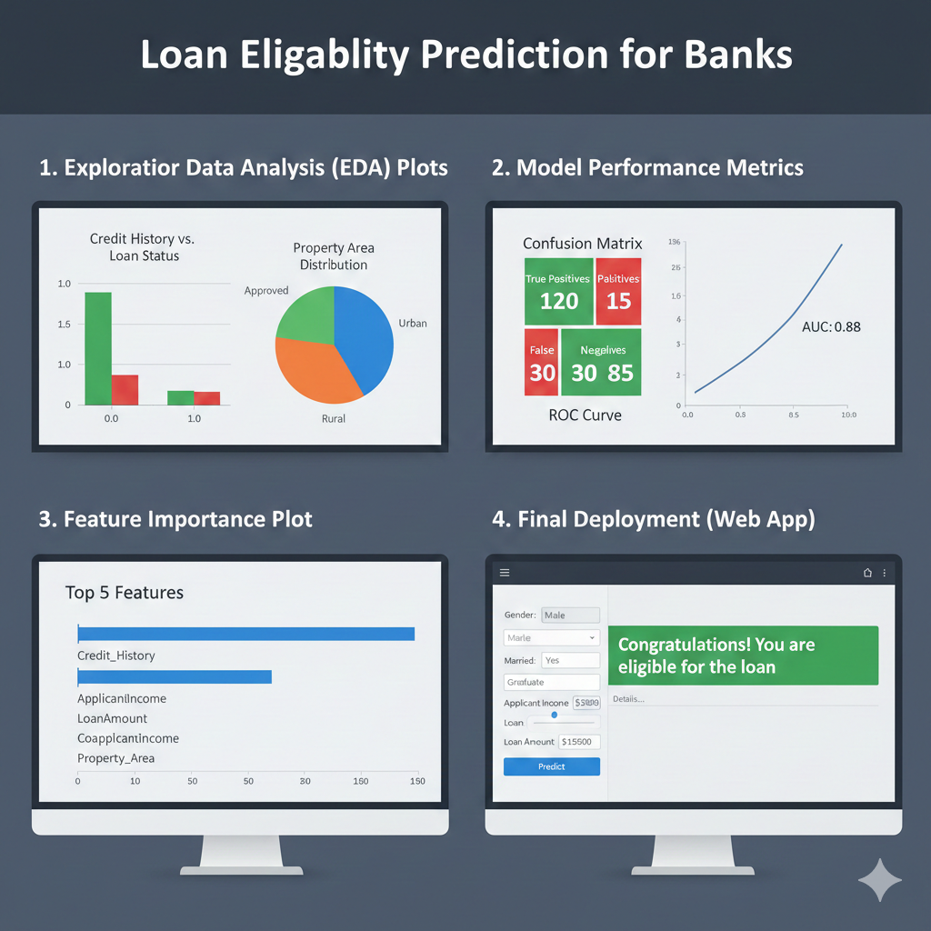
EXPECTED OUTCOMES

Slide 13
REFERENCES
1. Loan Eligibility Prediction Using Machine Learning — V. Sravan Kiran, B. Teja Reddy, D. Uday Kumar, K. Sai Avinash Varma, T. Sheshi Kiran (IJRASET)
2. Predicting Bank Loan Eligibility Using Machine Learning — Swathi Y. (IJSREM / open-access)
3. Loan Eligibility Prediction Using Machine Learning — Pinnamraju T S Priya, B. Bhanu Prakash (ISJEM, 2025)
4. Predicting Loan Eligibility Approval Using Machine Learning Algorithms — Guangxuan Chen (ICDSE 2024)
5. A Comparative Study of Machine Learning Algorithms for Predicting Loan Default and Eligibility — Supreeth S Athreyas, Thanmai B K, Varshini Kashyap S, Sukesh S Bairy, Harish K (PiCES Journal, 2022)

Slide 14
THANK YOU

